Slide 1

CSE 473
Pattern Recognition

Slide 2
Bayesian Classifier and its Variants

Slide 3
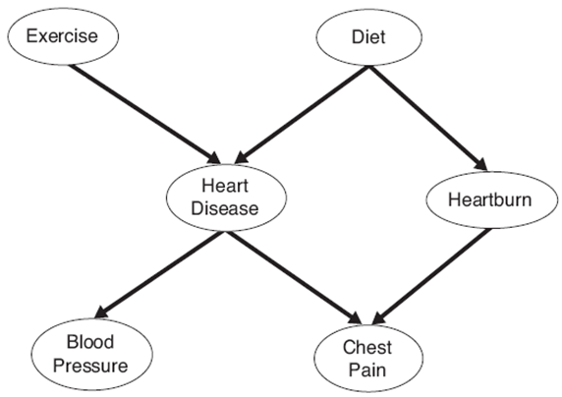
We will study this graph
Non-descendant conditions can be removed provided all parents are given
We can show:
P(D|E)=P(D)
P (Hb|HD, E, D,CP)= P (Hb|D, CP)
P (CP|Hb, HD, E, D)= P (CP|Hb, HD)
P (BP|CP, Hb, HD, E, D)= P (BP|HD)
However, P (HD|E,D) cannot be simplified

Slide 4
Exercise:
P (CP|HD, BP, E, D)= No simplification

Slide 5
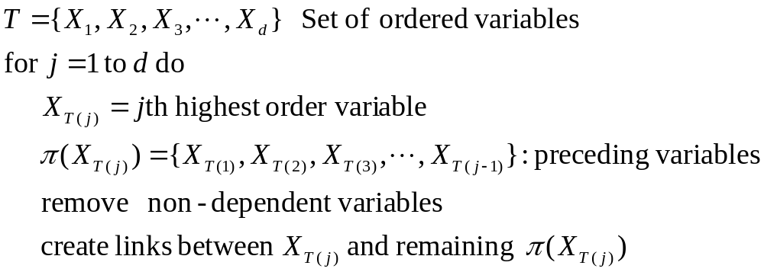
BBN Model Building

Slide 6
We will study this graph
Order: E, D, HD, Hb, CP, BP

Slide 7
We will study this graph
Order: E, D, HD, Hb, CP, BP

Slide 8
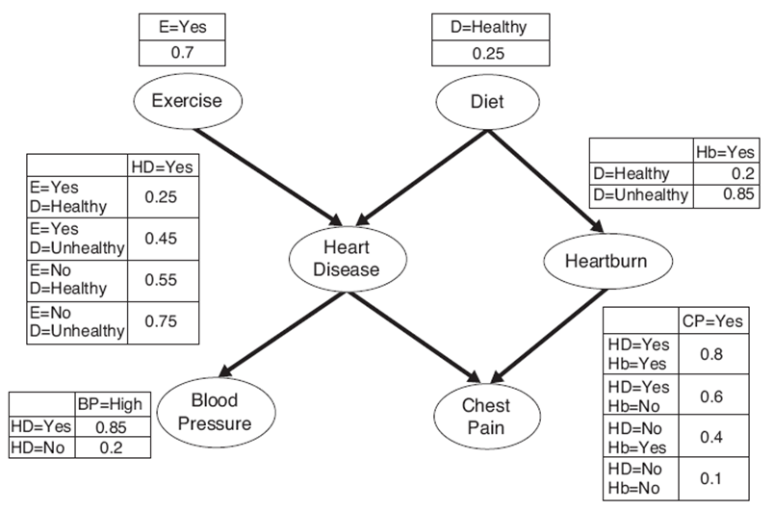
Calculate P(HD=yes) ?

Slide 9
Calculate P(HD=yes) ?
where,
α = Set of Values of Exercise(E) = {Yes, No}
β = Set of Values of Diet(D) = {Healthy, Not Healthy}

Slide 10
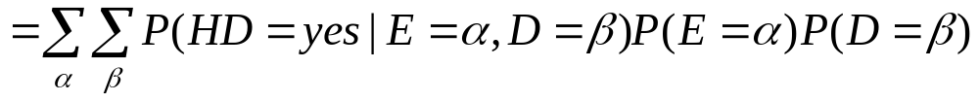
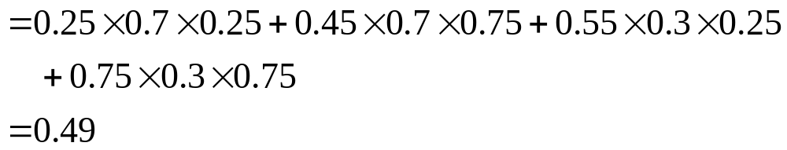
Calculate P(HD=yes) ?

Slide 11
Calculate: P(HD=yes|BP=High)?

Slide 12
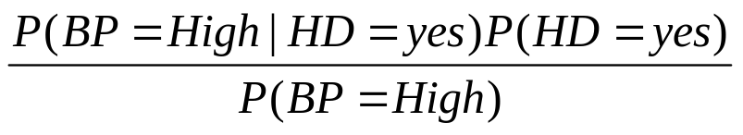

Calculate P(HD=yes|BP=High)
can be written as

Slide 13
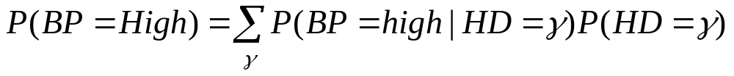
Calculate P(HD=yes|BP=High)
where,
γ = Set of Values of Heart Disease (HD) = {Yes, No}

Slide 14
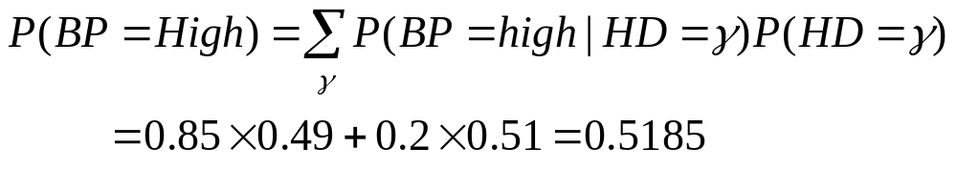
Calculate P(HD=yes|BP=High)

Slide 15
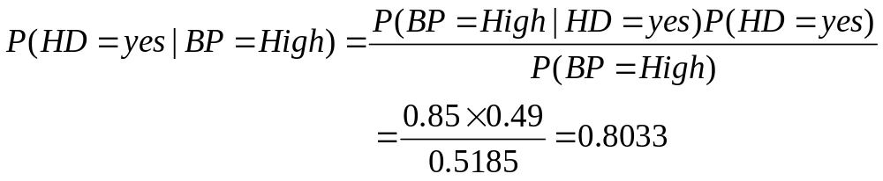
Calculate P(HD=yes|BP=High)

Slide 16
Calculate P(HD=yes|BP=high, D=Healthy, E=yes)?

Slide 17
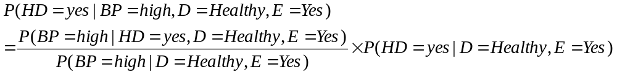
Calculate P(HD=yes|BP=high, D=Healthy, E=yes) ?

Slide 18
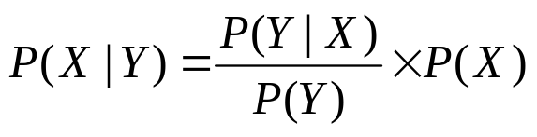
How is this formula true?
Let

Slide 19
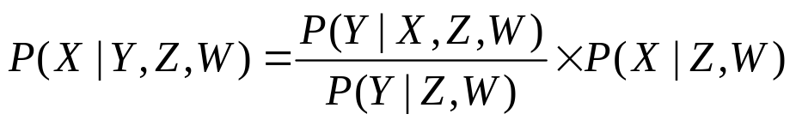
How is this formula true?
Let
Now add Z and W as condition

Slide 20
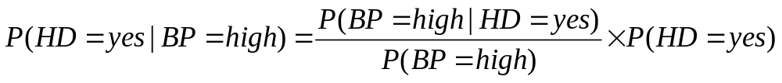
How is this formula true?
Let
Now add Z and W as condition
Similarly,

Slide 21
How is this formula true?
Let
Now add Z and W as condition
Similarly,
Now add conditions D= Healthy and E= Yes to above formula

Slide 22
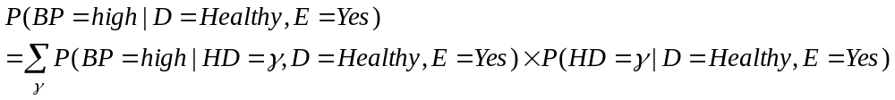
Similarly,

Slide 23
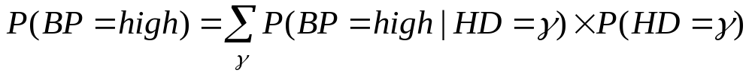
Similarly,
Proof:

Slide 24
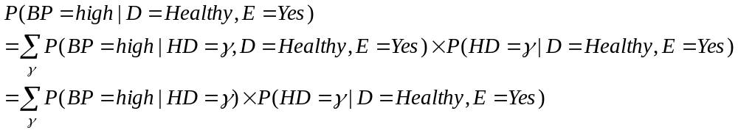
Similarly,
Proof:
Adding conditions D= Healthy and E= Yes
we get,

Slide 25
Similarly,
Proof:
Adding conditions D= Healthy and E= Yes
we get,

Slide 26
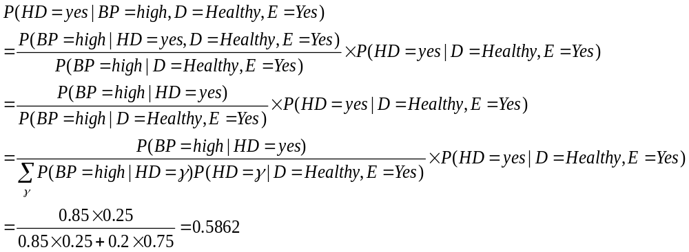

Slide 30
Review of Bayesian Classifier and its variants
underlying probability densities were known
training sample are used to estimate the probabilities

Slide 31
Linear Classifier: Introduction
Classifies linearly separable patterns
Assume proper forms for the discriminant functions
may not be optimal
very simple to use

Slide 32
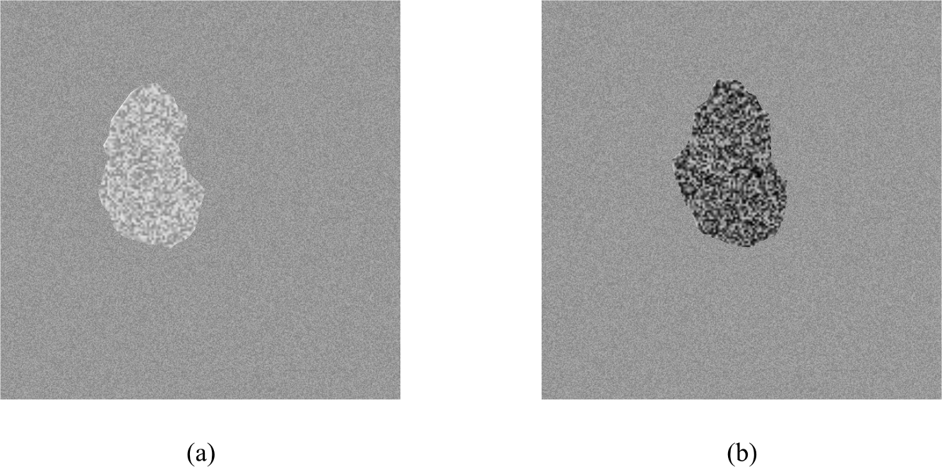
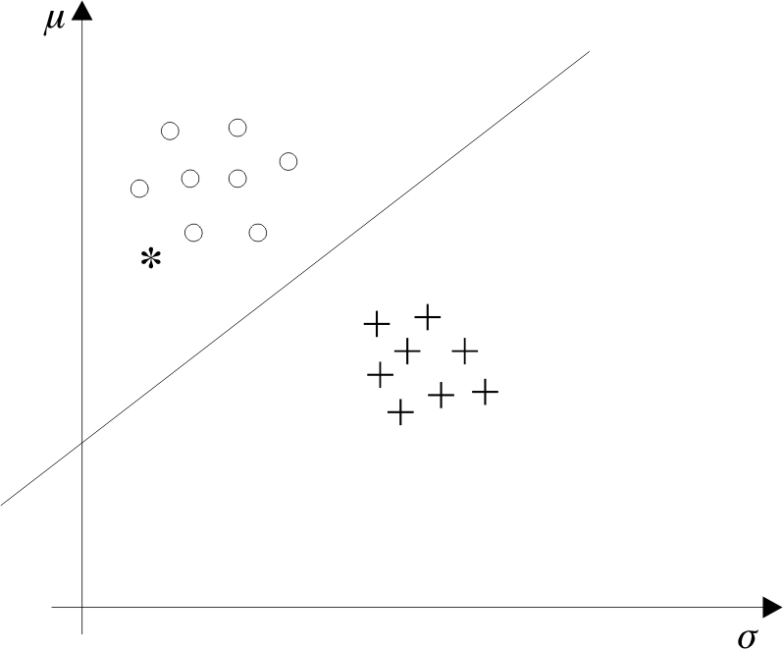
Recall from Lecture 1

Slide 33
Linear discriminant functions and decisions surfaces
Definition
  Let a pattern vector x = {x₁, x₂, x₃, …,}
  a weight vector w = {w₁, w₂, w₃, …,}
  A discriminant function :
  g(x)=x₁w₁+x₂w₂+x₃w₃+…
  OR
  g(x) = w^{t}x + w₀ (1)
  where w is the weight vector and w₀ the bias

Slide 34
Linear discriminant functions and decisions surfaces
Classify a new pattern x as follows
Decide class ω₁ if g(x) > 0
and class ω₂ if g(x) < 0
If g(x) = 0 ⇒ x is assigned to either class

Slide 35
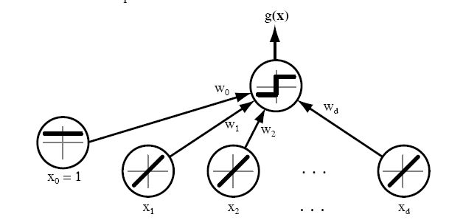
Linear discriminant functions and decisions surfaces

Slide 36
  The equation g(x) = 0 is the decision surface that separates patterns
  When g(x) is linear, the decision surface is a hyperplane

Slide 37
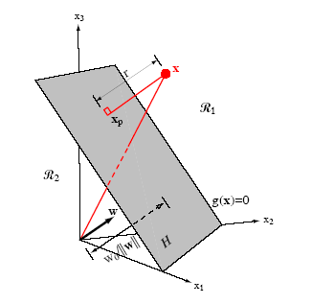

Slide 38
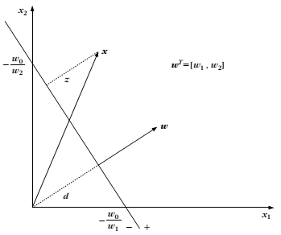

Slide 39
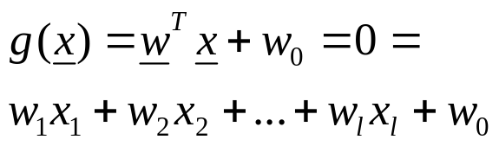
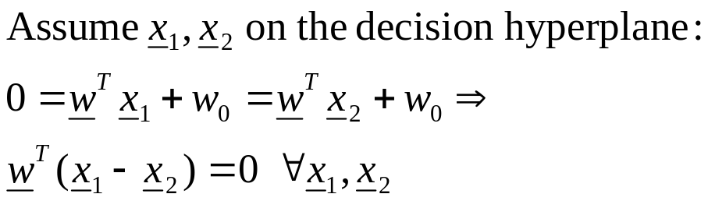
A little bit mathematics
The Problem: Consider a two class task with ω₁, ω₂

Slide 40

  Hence:

Slide 41
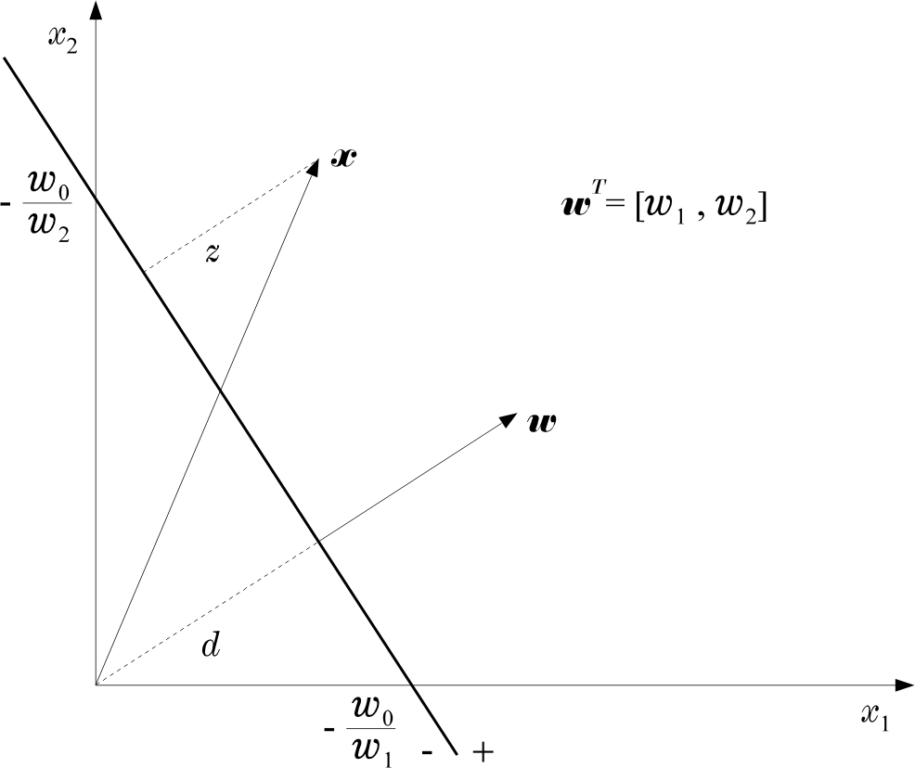
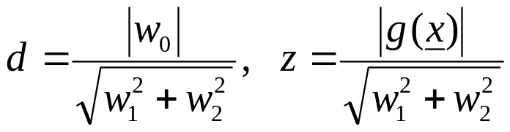
  Hence:

Slide 42
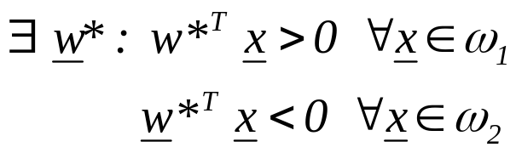
The Perceptron Algorithm
  Assume linearly separable classes, i.e.,

Slide 43
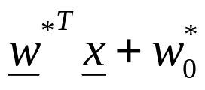
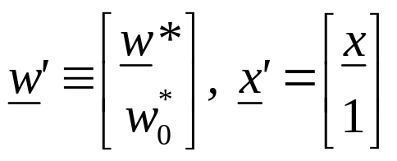
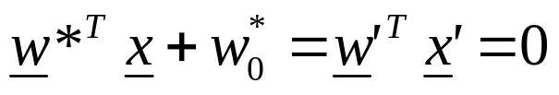
The Perceptron Algorithm
  Assume linearly separable classes, i.e.,
  The case
  falls under the above formulation, since

Slide 44
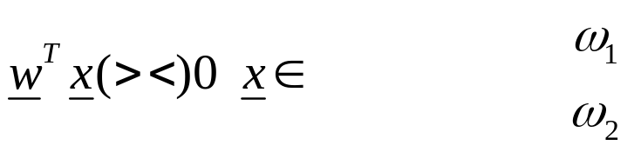
  Our goal: Compute a solution, i.e., a hyperplane w,
  so that
    The steps
      Define a cost function to be minimized
      Choose an algorithm to minimize the cost function
      The minimum corresponds to a solution

Slide 45
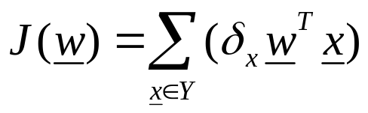
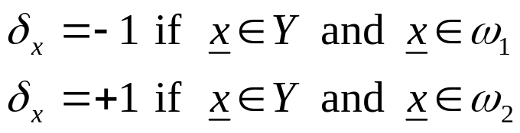
  The Cost Function
    Where Y is the subset of the vectors wrongly classified by w.

Slide 46
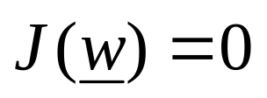
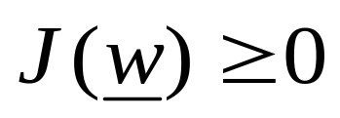
  The Cost Function
    Where Y is the subset of the vectors wrongly classified by w.
    when Y=(empty set) a solution is achieved and
    otherwise

Slide 47

    J(w) is piecewise linear (WHY?)
  The Algorithm
    The philosophy of the gradient descent is adopted.

Slide 48
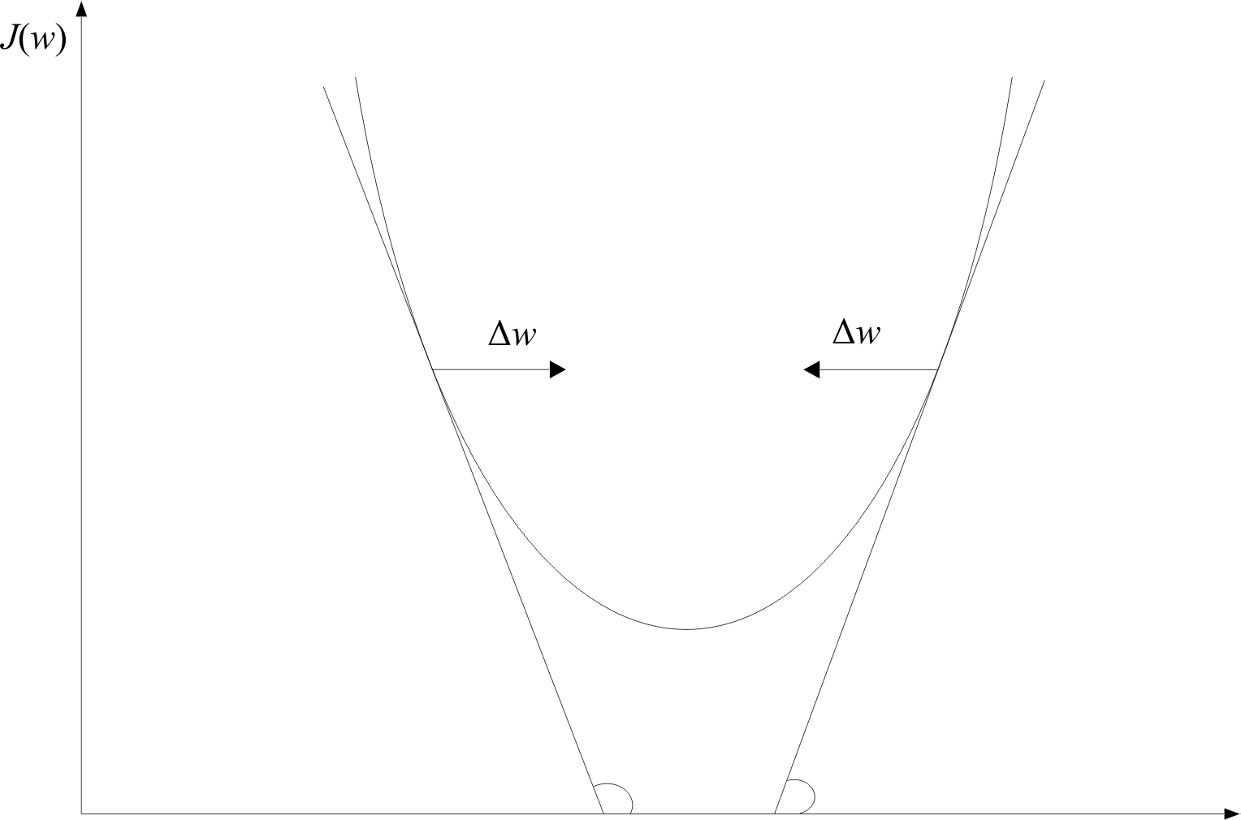
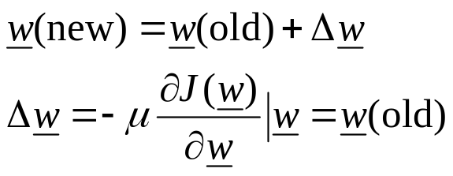
w

Slide 49
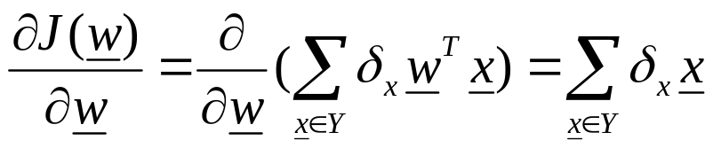
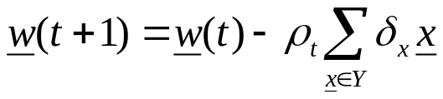
    Wherever valid
    This is the celebrated Perceptron Algorithm
w

Slide 50
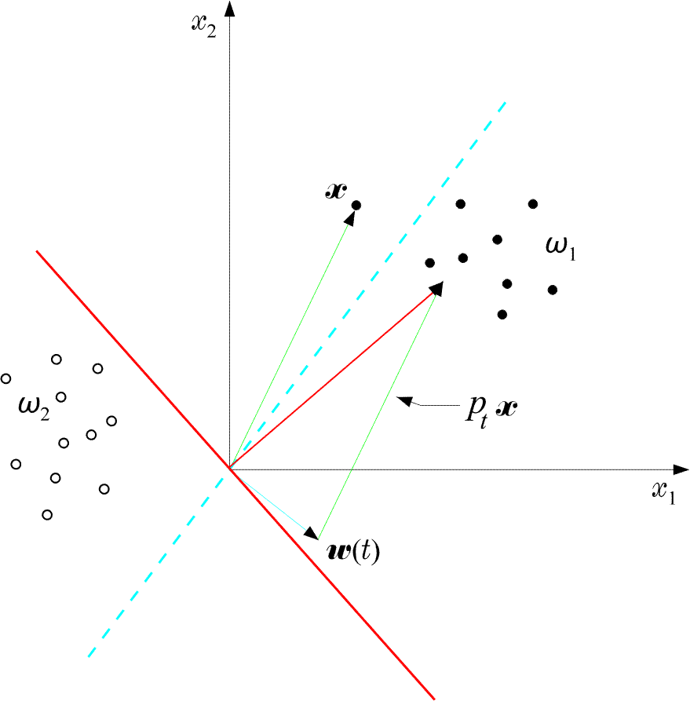
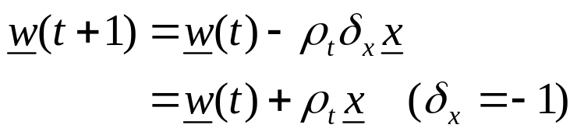
  An example:

Slide 51
  An example:
  The perceptron algorithm converges in a finite number of iteration steps to a solution if patterns are linearly separable

Slide 52

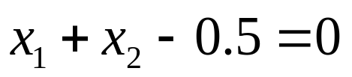
  Example: At some stage t the perceptron algorithm results in

Slide 53
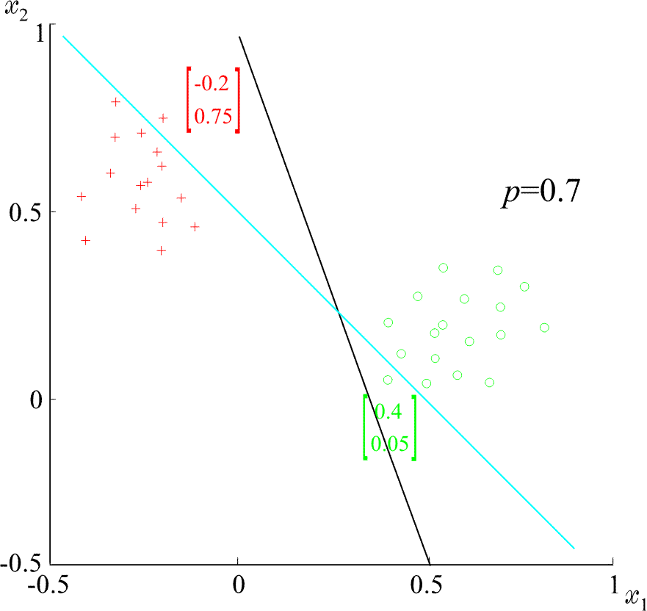
  Example: At some stage t the perceptron algorithm results in
  The corresponding hyperplane is
+
+
+
+
ρ=0.7
+
+
+

Slide 54
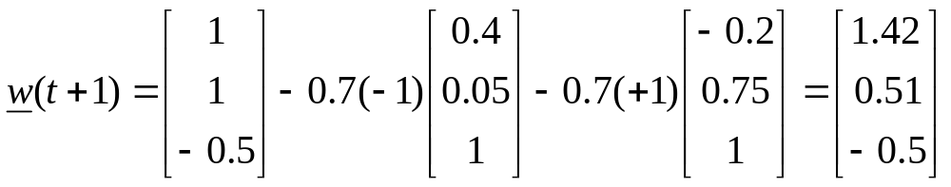
  Example: At some stage t the perceptron algorithm results in
  The corresponding hyperplane is
+
+
+
+
ρ=0.7
+
+
+

Slide 55
  Example: At some stage t the perceptron algorithm results in
  The corresponding hyperplane is
+
+
+
+
ρ=0.7
+
+
+

